Slide 1

Guitar Evaluation
Training CNN
Evaluating Fretboard

Slide 2
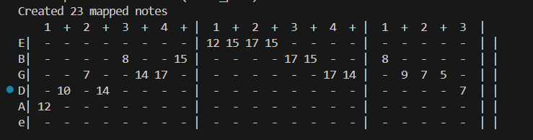
Fretboard Tab

Slide 3
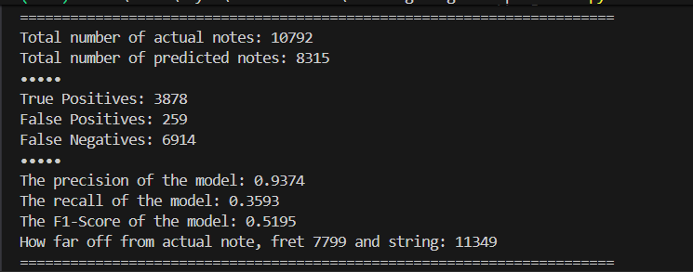
Fretboard Evaluation

